Slide 1
Online Detection and Classification of Dynamic Hand Gestures with Recurrent 3D Convolutional Neural Networks
Authors:
Pavlo Molchanov
Xiaodong Yang (NVIDIA)
Shalini Gupta (NVIDIA)
Kihwan Kim
Stephen Tyree
Jan Kautz
Published in:
IEEE Conference on Computer Vision and Pattern Recognition (CVPR) 2016

Slide 2
Challenge:
1. There is a large diversity in how people perform gestures, making detection and classification difficult. 2. The system must work online in order to avoid noticeable lag between performing a gesture and its classification.

Slide 3
Main Work:
1. A recurrent three-dimensional convolutional neural network that performs simultaneous detection and classification of dynamic hand gestures from multi-modal data.
2. An online gesture classification system for driving.

Slide 4
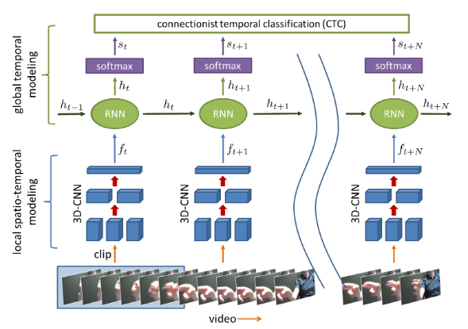
System Framework:

Slide 5
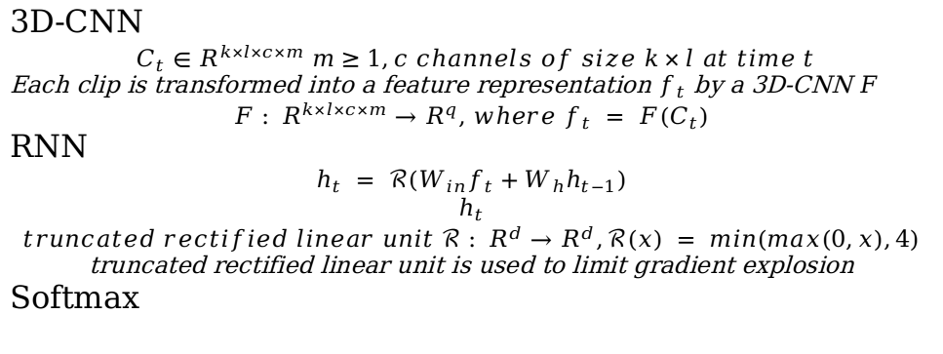
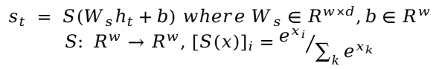
Network Architecture:

Slide 6
Training:
1. Pre-training the 3D-CNN 2. Training the full model
3. Connectionist temporal classification
4. Implementation

Slide 7
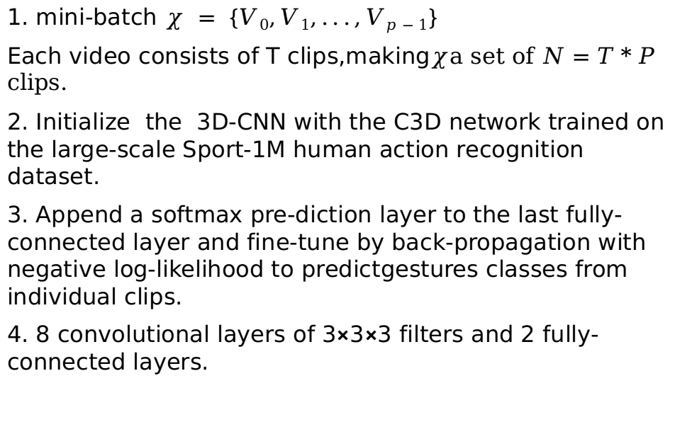
1. Pre-training the 3D-CNN
1. mini-batch $χ = \{V0,V1,...,Vp−1\}$
Each video consists of T clips,making$χ$a set of $N=T*P$ clips.
2. Initialize the 3D-CNN with the C3D network trained on the large-scale Sport-1M human action recognition dataset.
3. Append a softmax pre-diction layer to the last fully-connected layer and fine-tune by back-propagation with negative log-likelihood to predictgestures classes from individual clips.
4. 8 convolutional layers of 3×3×3 filters and 2 fully-connected layers.

Slide 8
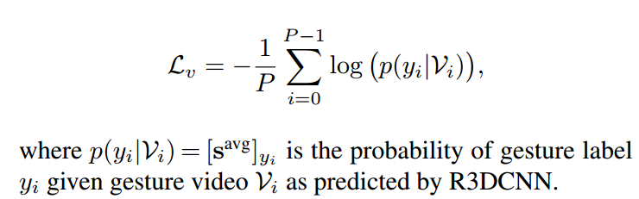
2. Training the full model
1. Train the entire R3DCNN with back-propagation-through-time (BPTT).
2. Consider two training cost functions: negative log-likelihood for the entire video and connectionist temporalclassification (CTC) for online sequences.

Slide 9
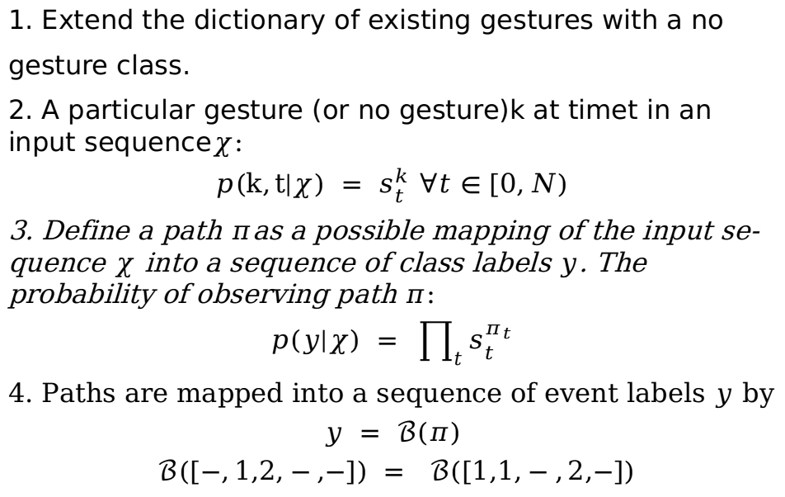
3. Connectionist temporal classification
1. Extend the dictionary of existing gestures with a no
gesture class.
2. A particular gesture (or no gesture)k at timet in an input sequence$χ$:
$$p(k,t|χ) = s_{t}^{k} ∀t∈[0,N)$$
3. Define a path $π$as a possible mapping of the input se-quence $χ$ into a sequence of class labels $y$. The probability of observing path $π$:
$$p(y|χ) = \prod_{t}{s_{t}^{π_{t}}}$$
4. Paths are mapped into a sequence of event labels $y$ by
$$y = ℬ(π)$$
$$ℬ([−,1,2,−,−]) = ℬ([1,1,−,2,−])$$

Slide 10
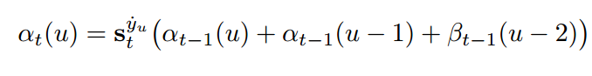
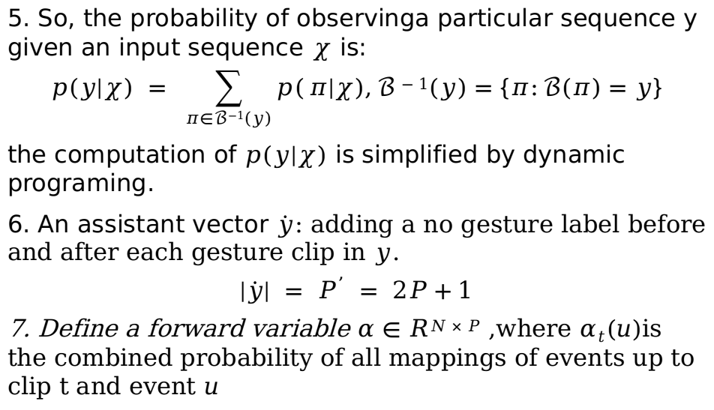
3. Connectionist temporal classification
5. So, the probability of observinga particular sequence y given an input sequence $χ$ is:
$$p(y|χ) = \sum_{π∈ℬ−1(y)}{p(}π|χ),ℬ−1(y)=\{π:ℬ(π)=y\}$$
the computation of $p(y|χ)$ is simplified by dynamic programing.
6. An assistant vector $\dot{y}$: adding a no gesture label before and after each gesture clip in $y$.
$$|\dot{y}| = P^{’} = 2P+1$$
7. Define a forward variable $α∈RN×P$ ,where $αt(u)$is the combined probability of all mappings of events up to clip t and event $u$

Slide 11
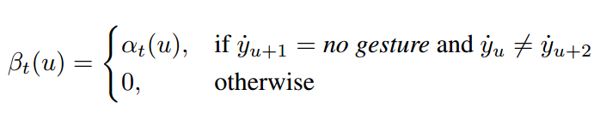
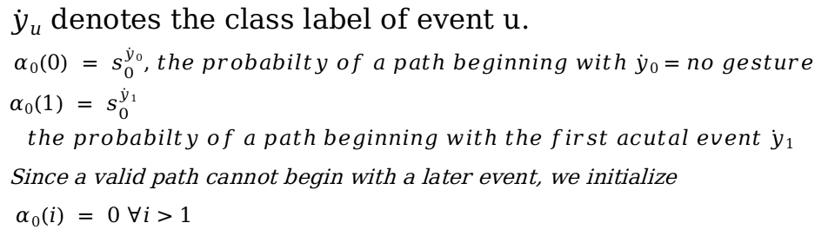
3. Connectionist temporal classification
$\dot{y}u$ denotes the class label of event u.
$$α0(0) = s_{0}^{\dot{y}0}, the probabilty of a path beginning with \dot{y}0=no gesture$$
$$α0(1) = s_{0}^{\dot{y}1}$$
$$the probabilty of a path beginning with the first acutal event\dot{ y}1$$
Since a valid path cannot begin with a later event, we initialize
$α0(i) = 0 ∀i>1$

Slide 12
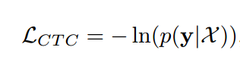
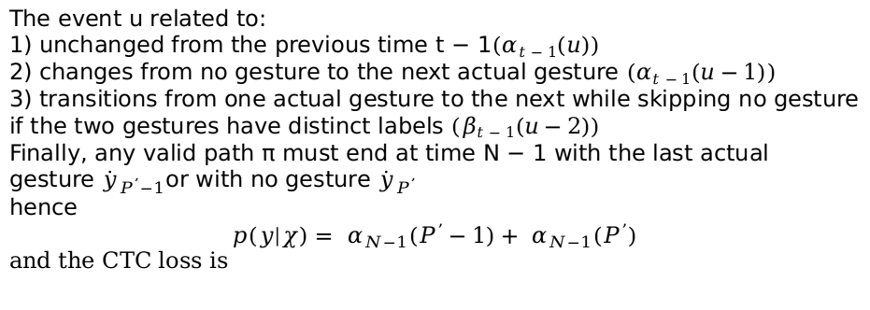
3. Connectionist temporal classification
The event u related to:
1) unchanged from the previous time t − 1$(αt−1(u))$
2) changes from no gesture to the next actual gesture $(αt−1(u−1))$
3) transitions from one actual gesture to the next while skipping no gesture if the two gestures have distinct labels $(βt−1(u−2))$
Finally, any valid path π must end at time N − 1 with the last actual gesture ${\dot{y}}_{P^{’}−1}$or with no gesture ${\dot{y}}_{P^{’}}$
hence
$$p(y|χ)= α_{N−1}(P^{’}−1)+ α_{N−1}(P^{’})$$
and the CTC loss is

Slide 13
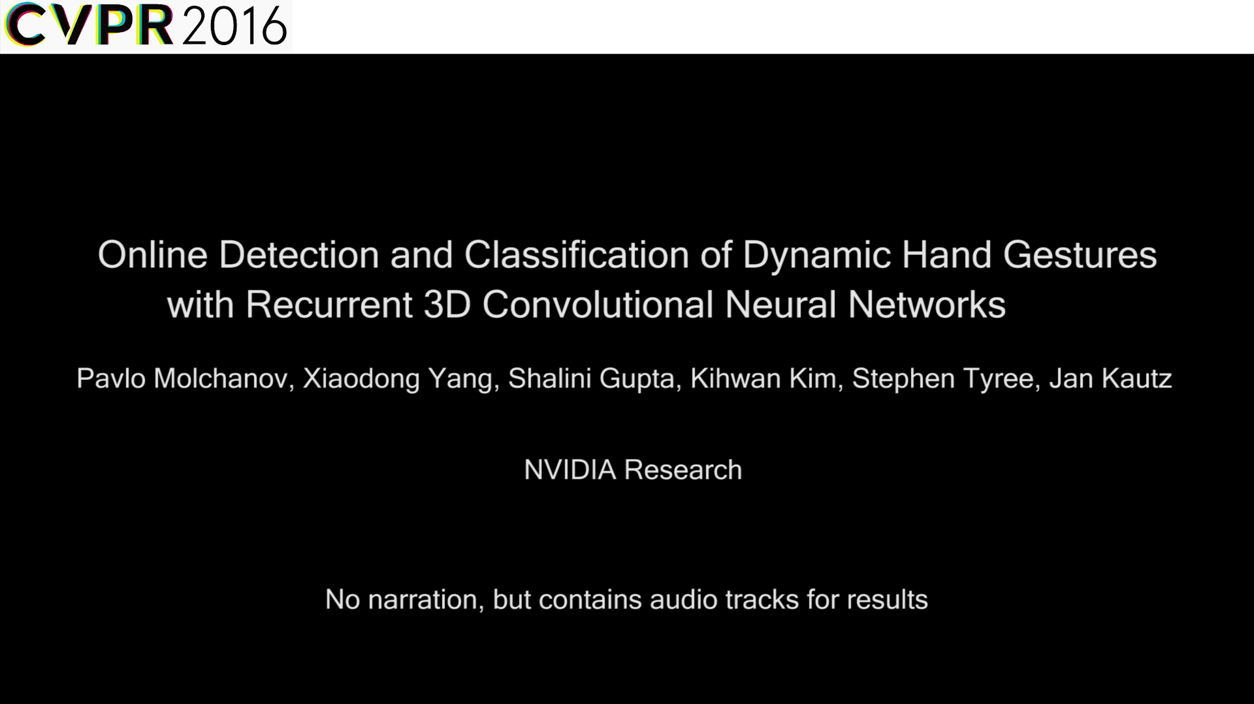
4. Implementation

Slide 14
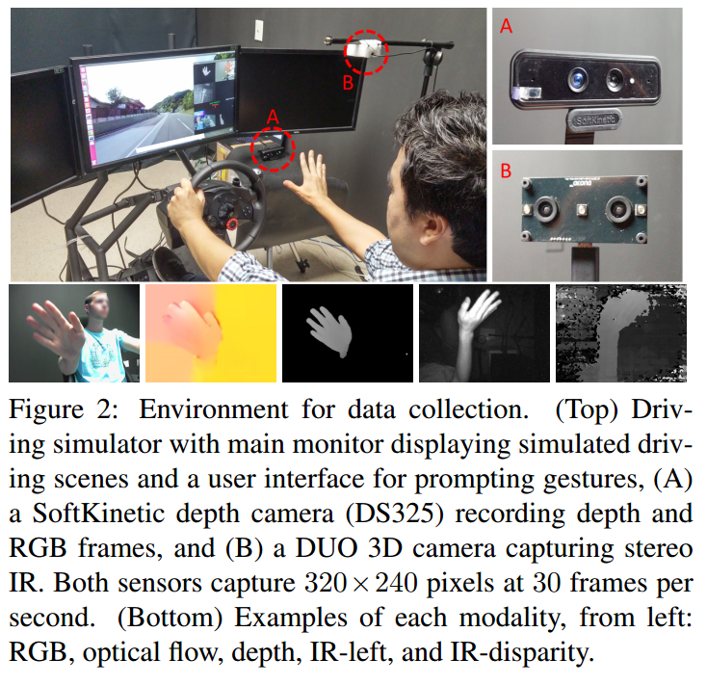
Database:

Slide 15
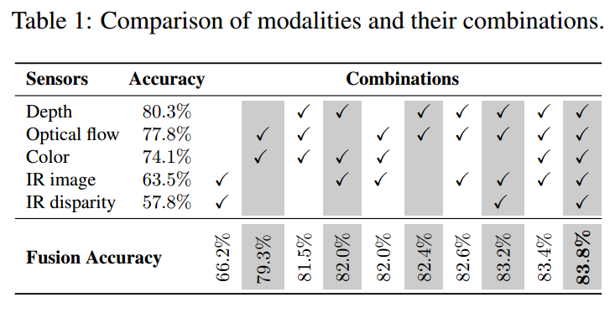
Modality fusion:
The best gesture recognition accuracy (83.8%) is observed for the combination of all modalities.

Slide 16
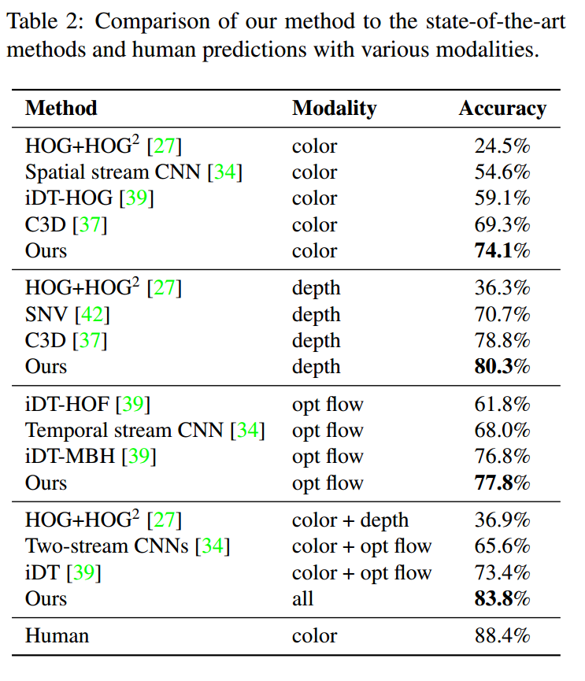
Comparisons:

